Slide 1
Need for increased cybersecurity today
Alexander Bal

Slide 2

Table of contents
An example of a data breach
Why we need cybersecurity
How to minimize the risk of cyberattacks
A brief summary
Q&A

Slide 3
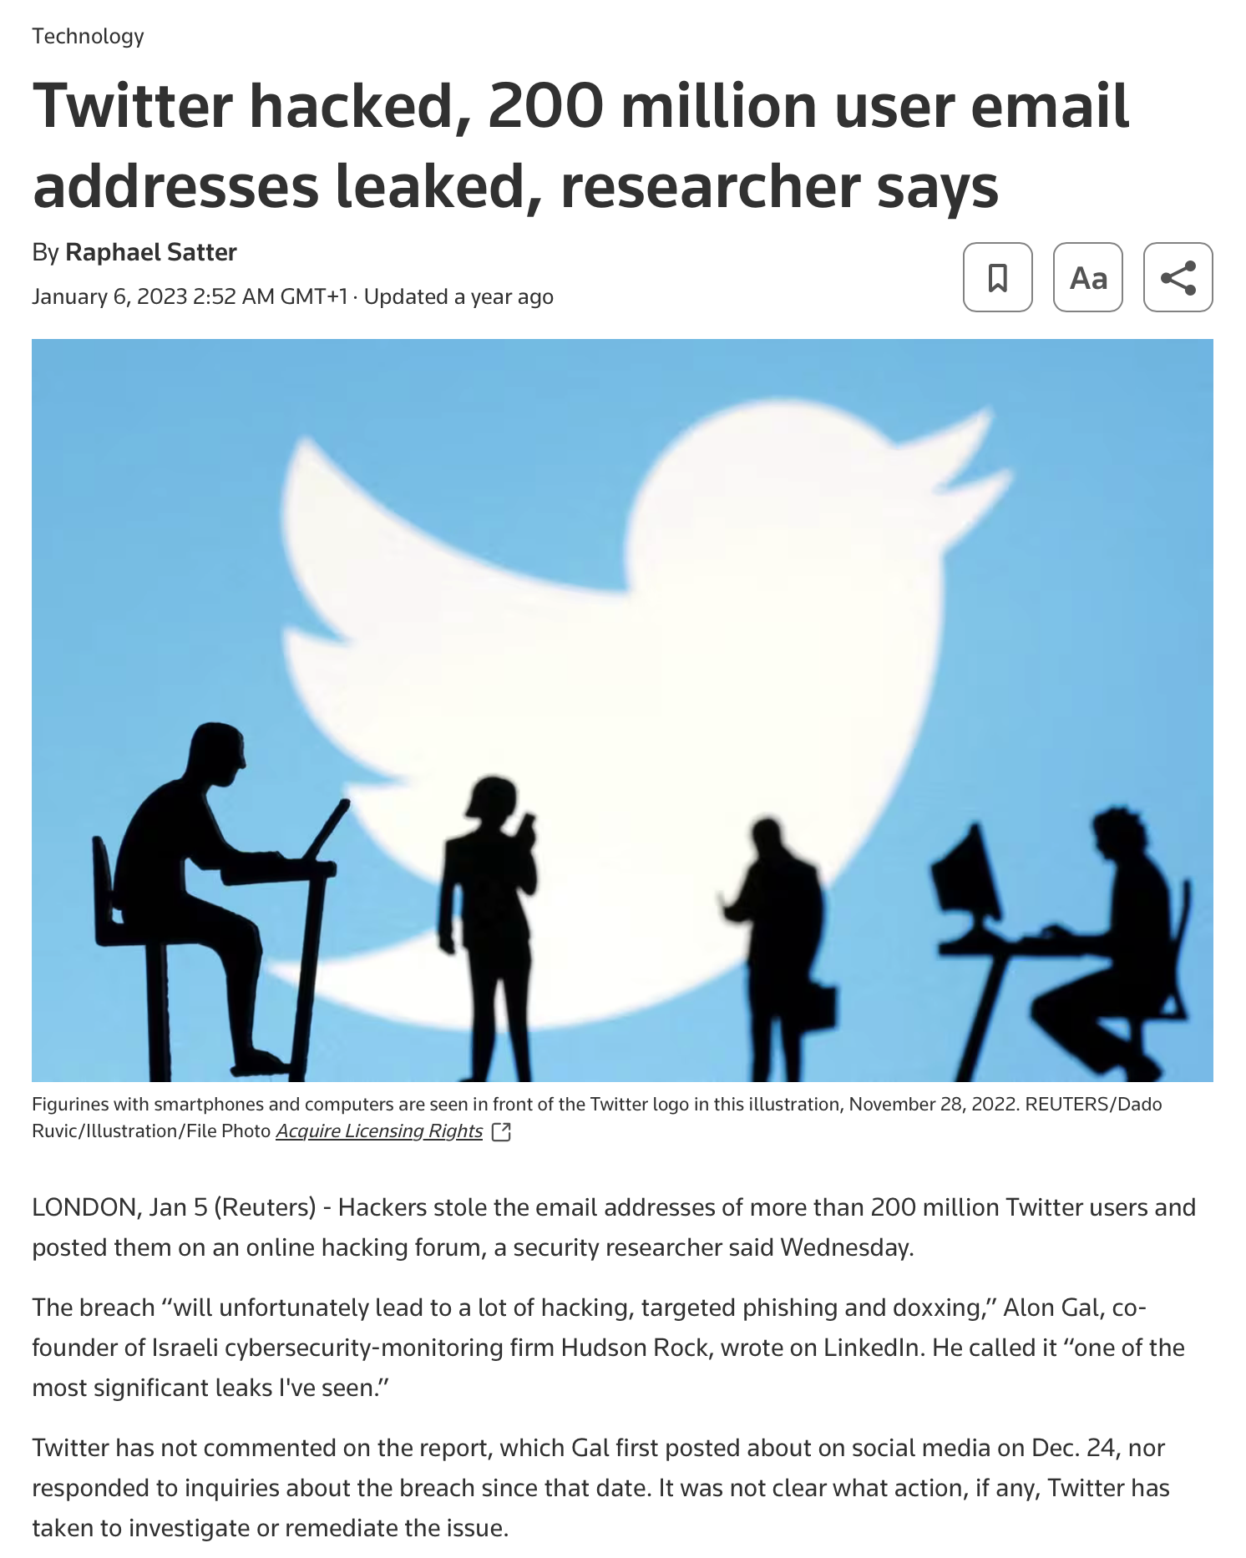
200 million users affected
Leaked email adresses
Phishing and doxxing

Slide 4

Why do we need cybersecurity?
Preventing attacks
User data protection

Slide 5
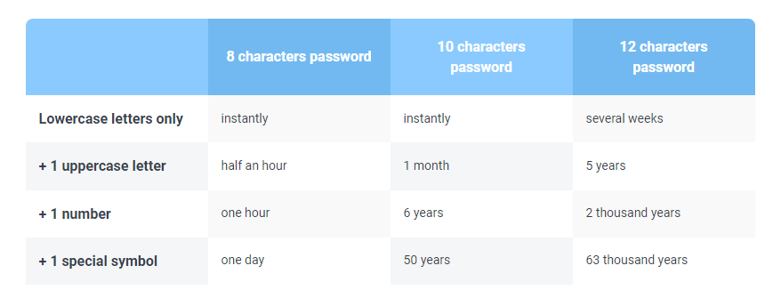
How to minimize the risk of cyberattacks?
Up to date software
Up to date antivirus software
Strong passwords

Slide 6
Summary
Cybersecurity -> Protection of data
Minimize risk of attacks
Up to date software
Up to date antivirus software
Strong passwords

Slide 7
Q&A
Now I will answer some questions

Slide 8
Sources
Satter, R. (2023, 6 januari). Twitter hacked, 200 million user email addresses leaked, researcher says. Reuters. https://www.reuters.com/technology/twitter-hacked-200-million-user-email-addresses-leaked-researcher-says-2023-01-05/
Images: Unsplash

Slide 9
The end of my presentation
Alexander Bal

